Slide 1
#BidenCheated Hashtag and How Quickly It Spread on Twitter
Second Forensics Study CS895 F2020
2020-12-17
Peter Foytik

Slide 2
At end of November 2020 Twitter accounts were seen spamming #BidenCheated
How far did these spammed tweets reach across a potential twitter network?
The tweets are public but how many accounts had direct access to it (through followers)
How many of these following accounts also participated in the spamming act
What was the rate of the spread of information based on follower's activity?
Was there bot activity that is detectable and how much did this contribute to the spread of disinformation?

Slide 3
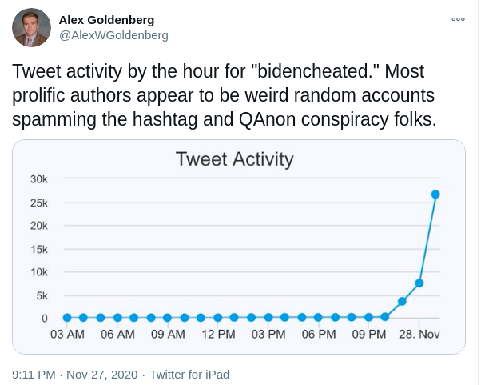
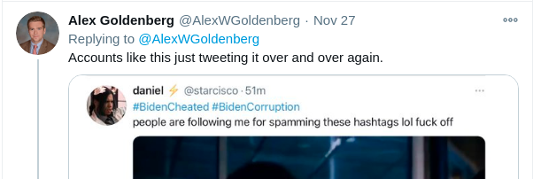
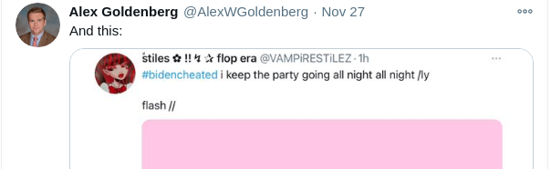
Alex Goldenberg tweeted November 27 on how many users were tweeting #BidenCheated.
https://twitter.com/AlexWGoldenberg/status/1332507392840503298

Slide 4
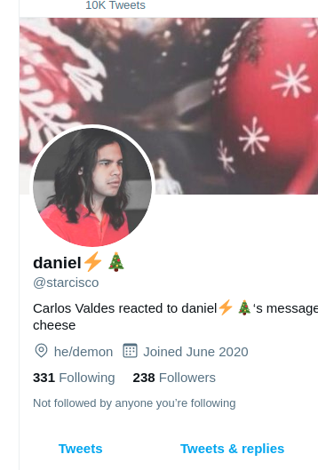
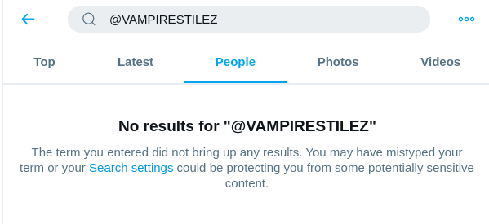
Two accounts mentioned from Alex Goldenberg "Starcisco" and "Vampirestilez"
Managed to scrape tweets with "#BidenCheated" and followers for VAMPIRESTILEZ before account was removed!
Unfortunately, the account was not archived

Slide 5
Things that likely contribute to the spread of information
Network reach
Number of followers
Willingness of followers to contribute
Information Frequency
Speed at which the information is transmitted
Is there a sweet spot?
Too fast might give away malicious motive
Too slow might not get the message out
https://blog.twitter.com/engineering/en_us/topics/insights/2017/using-deep-learning-at-scale-in-twitters-timelines.html

Slide 6
Tools used to obtain data for analysis
Twint (https://github.com/twintproject/twint)
scrape tweets containing "#BidenCheated"
twint –s "#BidenCheated" --since 2020-10-28
Twitter API (Twitter Developer https://developer.twitter.com/en)
Scrape follower accounts of participants
Botometer API ( https://botometer.osome.iu.edu/api RapidAPI)
Score participants to get an idea of the possibility of being a bot
Python

Slide 7
Summary #BidenCheated Tweets
Total data set covers dates from 2008-10-25 – 2020-12-05
Total number of tweets scraped: 305,781
Number of accounts follwers scraped: 366
Total accounts analyzed: 102,979
Total number scored with Botometer: 6,938 (7% of total)

Slide 8
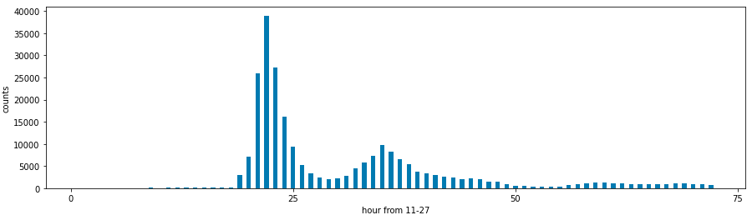
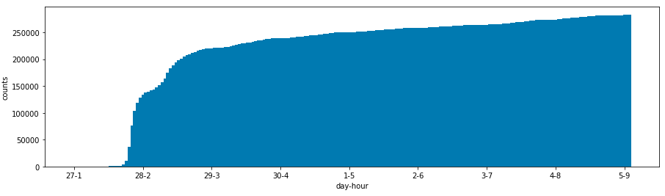
Rate of tweets with BidenCheated hashtag
Frequency by Hour
Max tweets per hour (TPH):
- Nov 27
- hour 22
- TPH = 38,991
Average TPH:
- 1,395
Cumulative Tweets

Slide 9
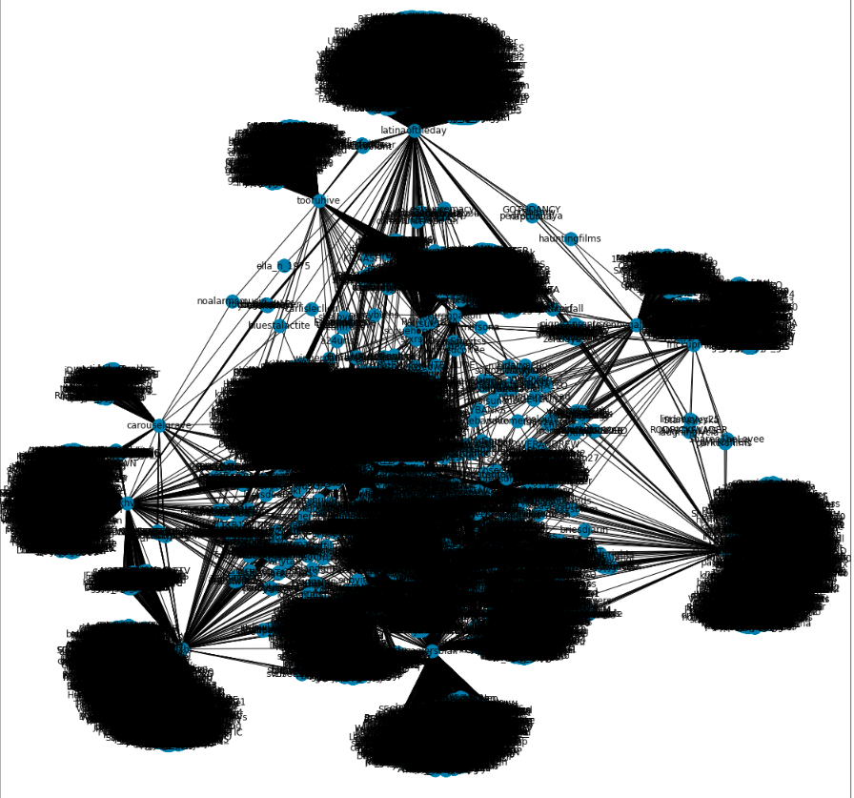
Full network of all participants and their followers (Can't really get much from this)
Parent accounts: 366
All parent accounts were participants in BidenCheated hashtag
Average follower per account: 1,884
Max follower per account: 138,511

Slide 10
Batometer results for the collection involved in the BidenCheated spam
Botometer scores are retrieved for all accounts that participated in BidenCheated
Total accounts retrieved
6,938
Average Bot Score:
1.9
Median Bot Score:
1.4
Number of Bots >= 4
1,111
9 accounts being scored by Botometer were removed and could not be scored.

Slide 11
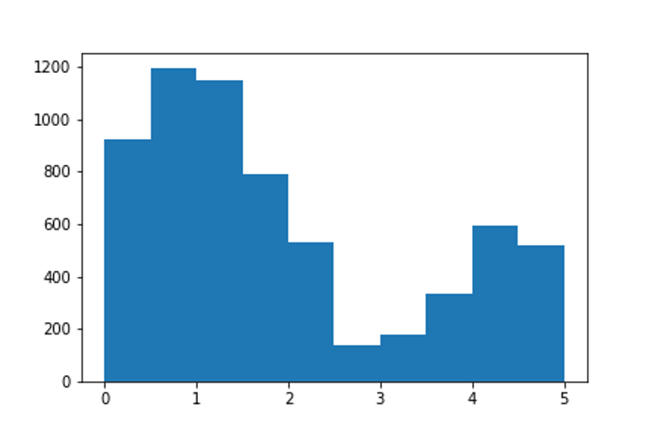
Histogram of total bot scores

Slide 12
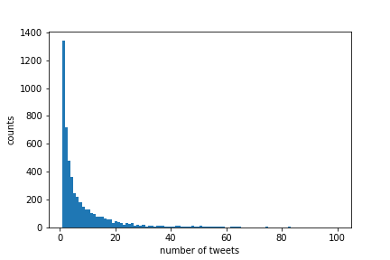
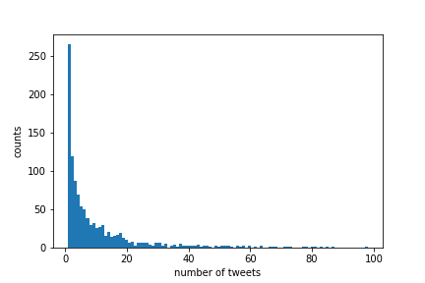
Bot contribution to BidenCheated (Botometer score >= 4)
Total Unique accounts = 102,979
Total nonBot accounts = 5,260 Total Bot accounts = 1,111
Frequency of number of BidenCheated tweets for nonBot
Frequency of number of BidenCheated tweets for Bot

Slide 13
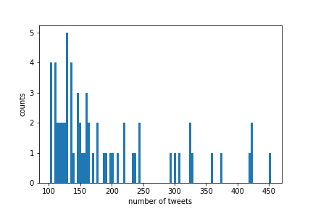
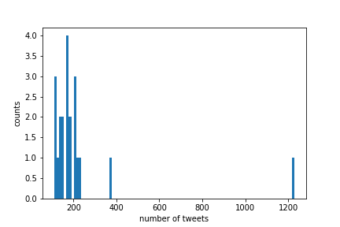
Maximum frequency of tweets from non-bot users and bot users
Frequency of largest number of BidenCheated tweets for non-bot
Frequency of largest number of BidenCheated tweets for bot

Slide 14
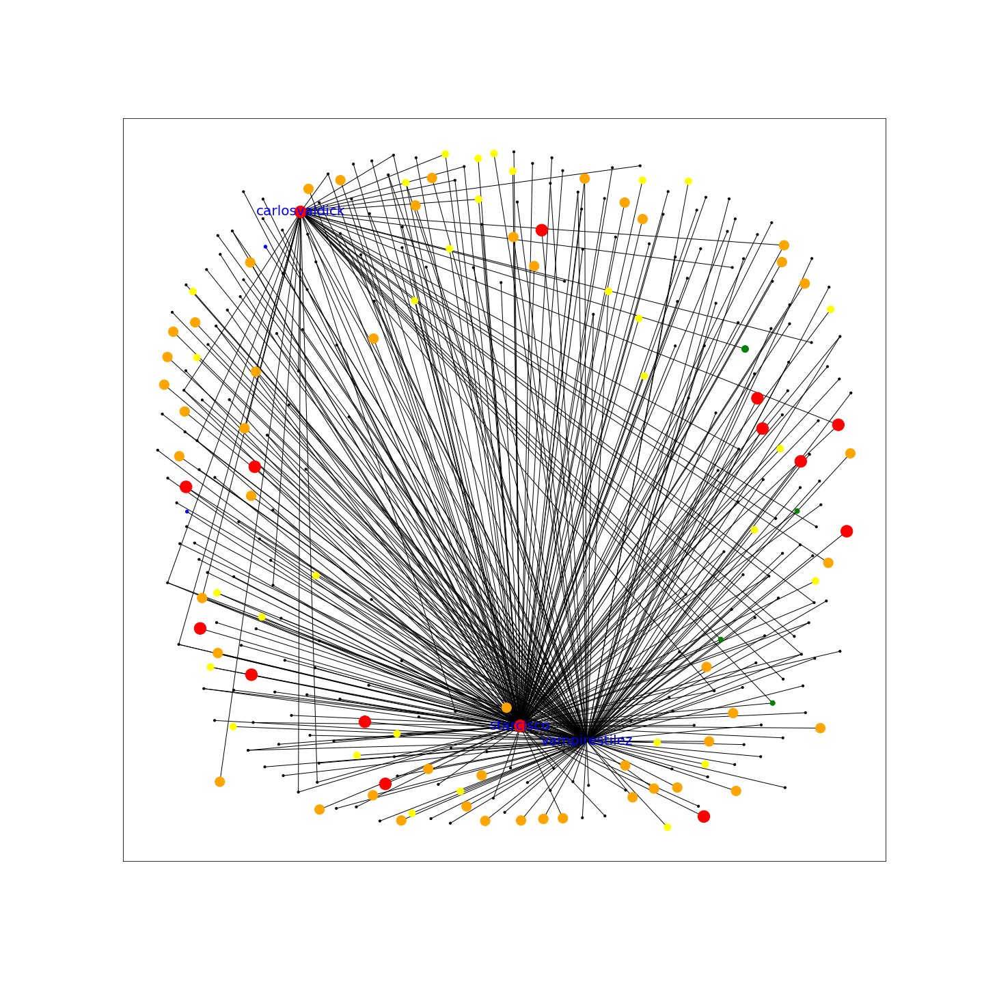
Three targets: carlosvaldick, starcisco, vampirstilez Nodes are colored based on bot score (0-5 greater number more bot like). - 0 - 1 - 2 - 3 - 4 - 5

Slide 15
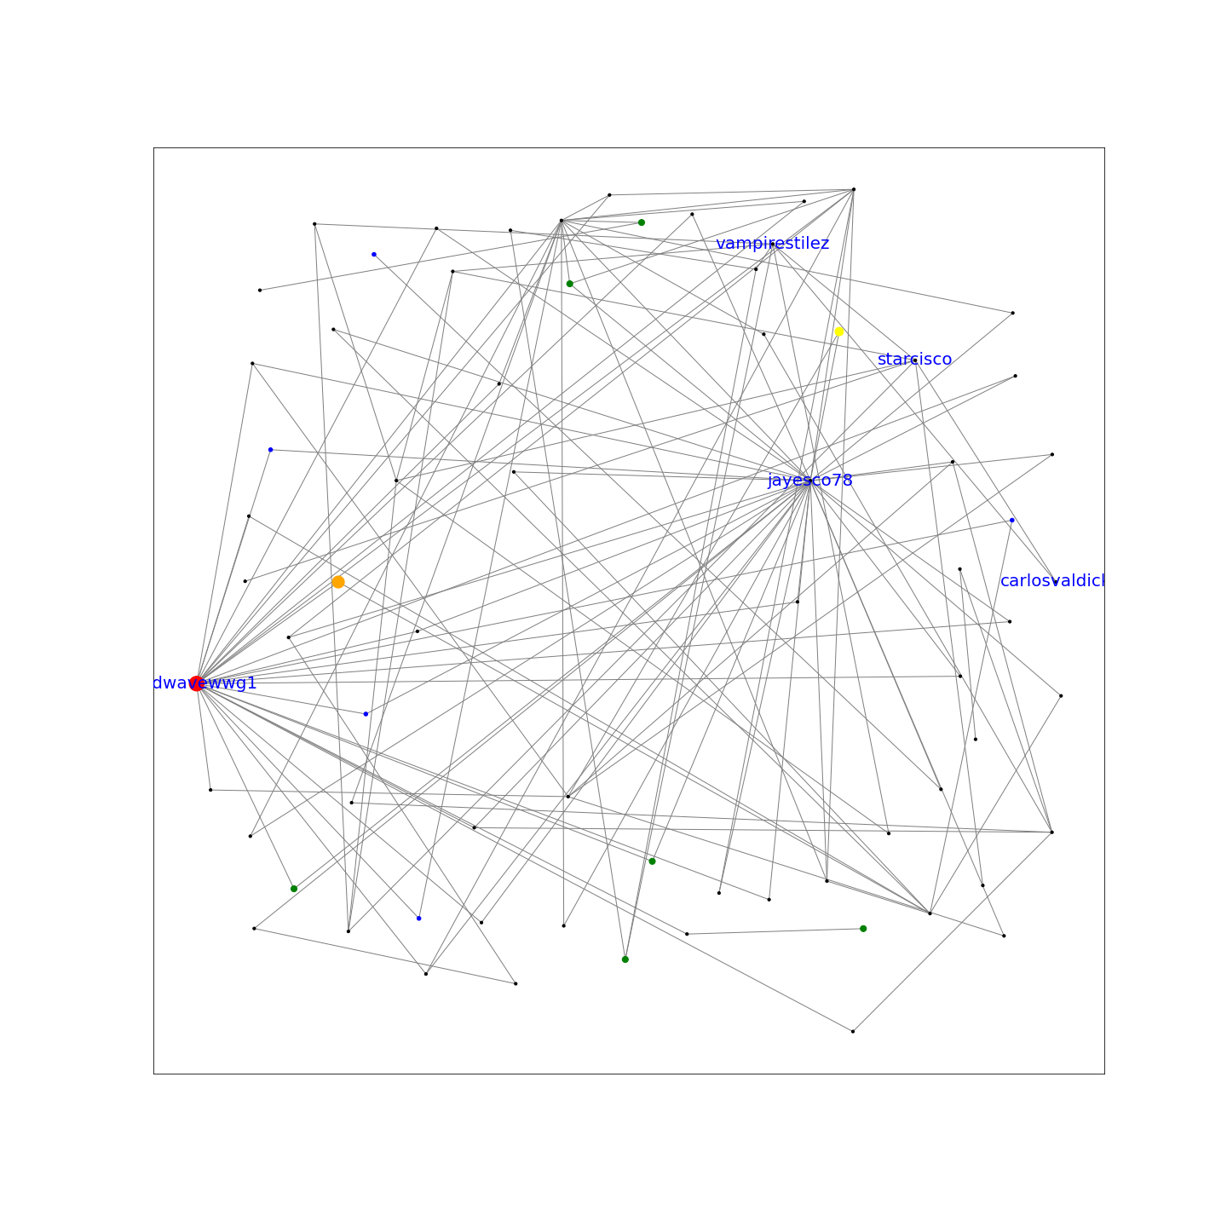
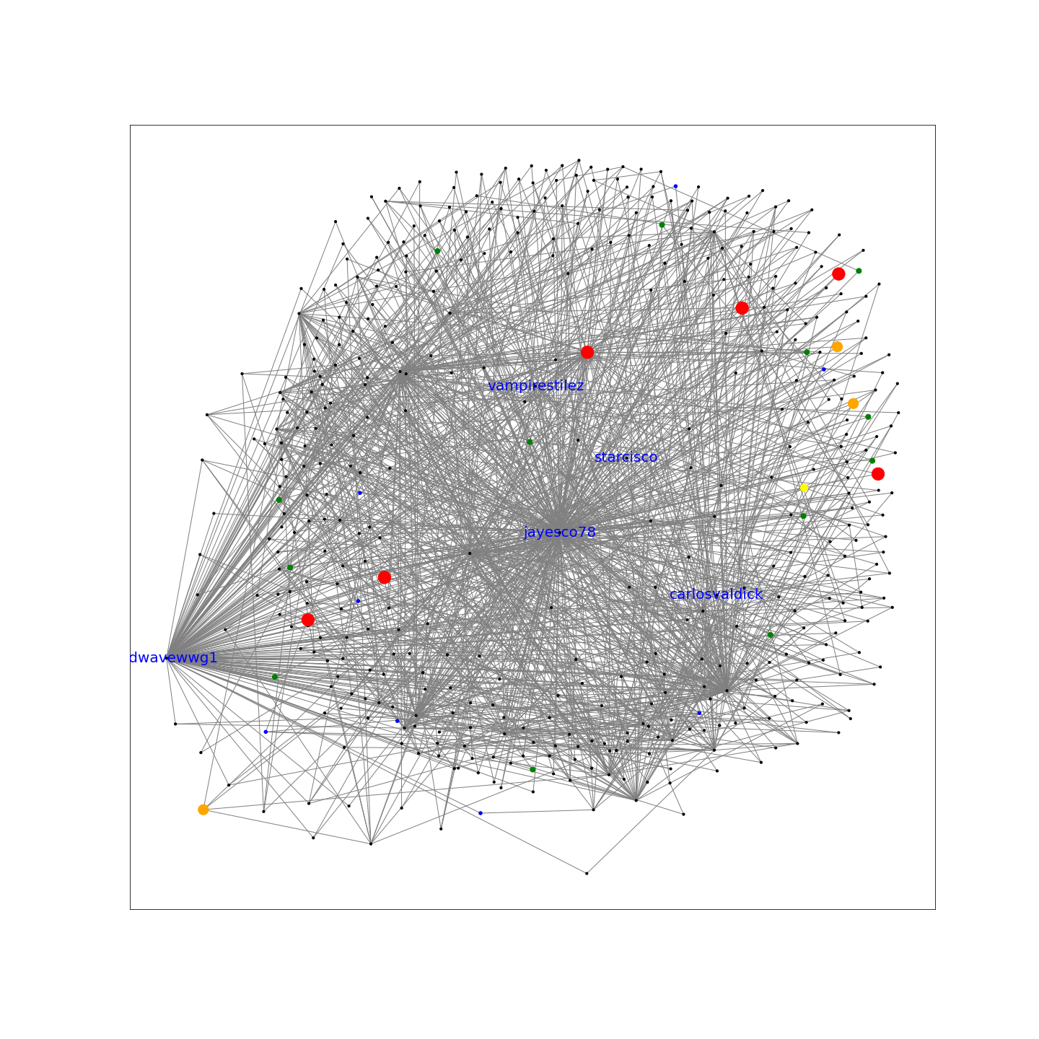
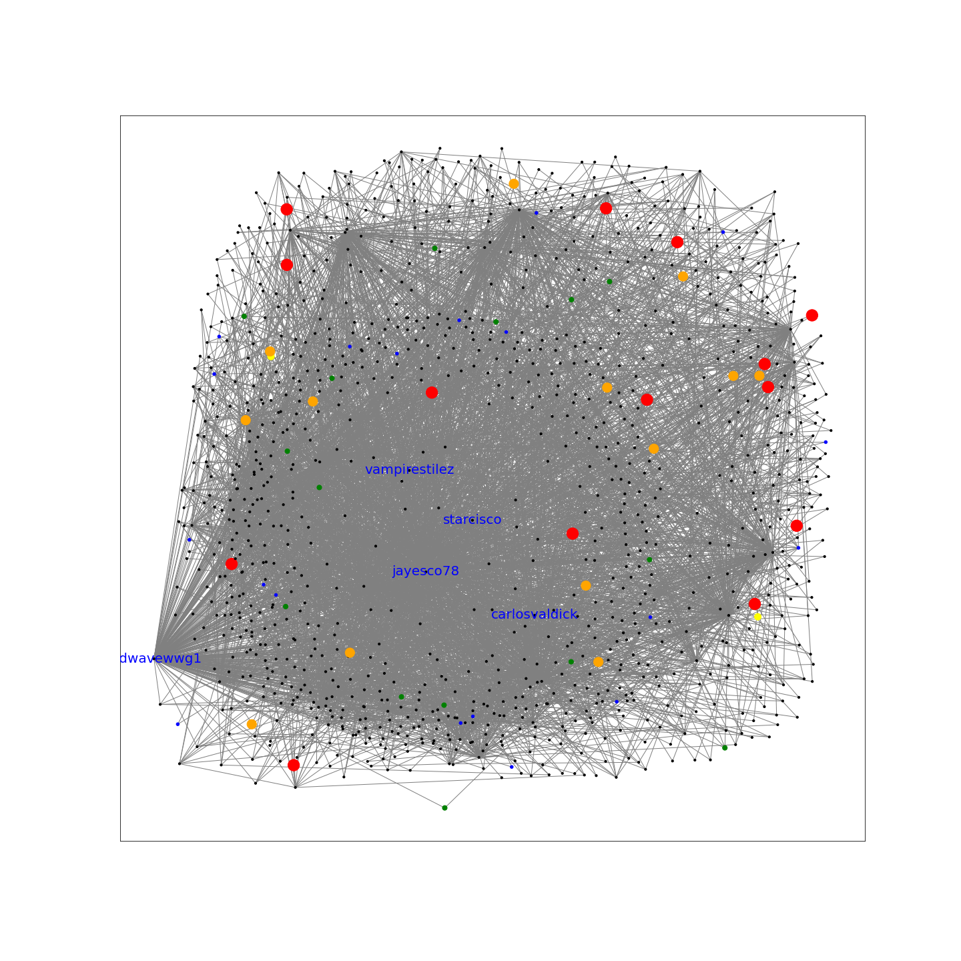
BidenCheated propagation over time and identified additional highly connected accounts

Slide 16
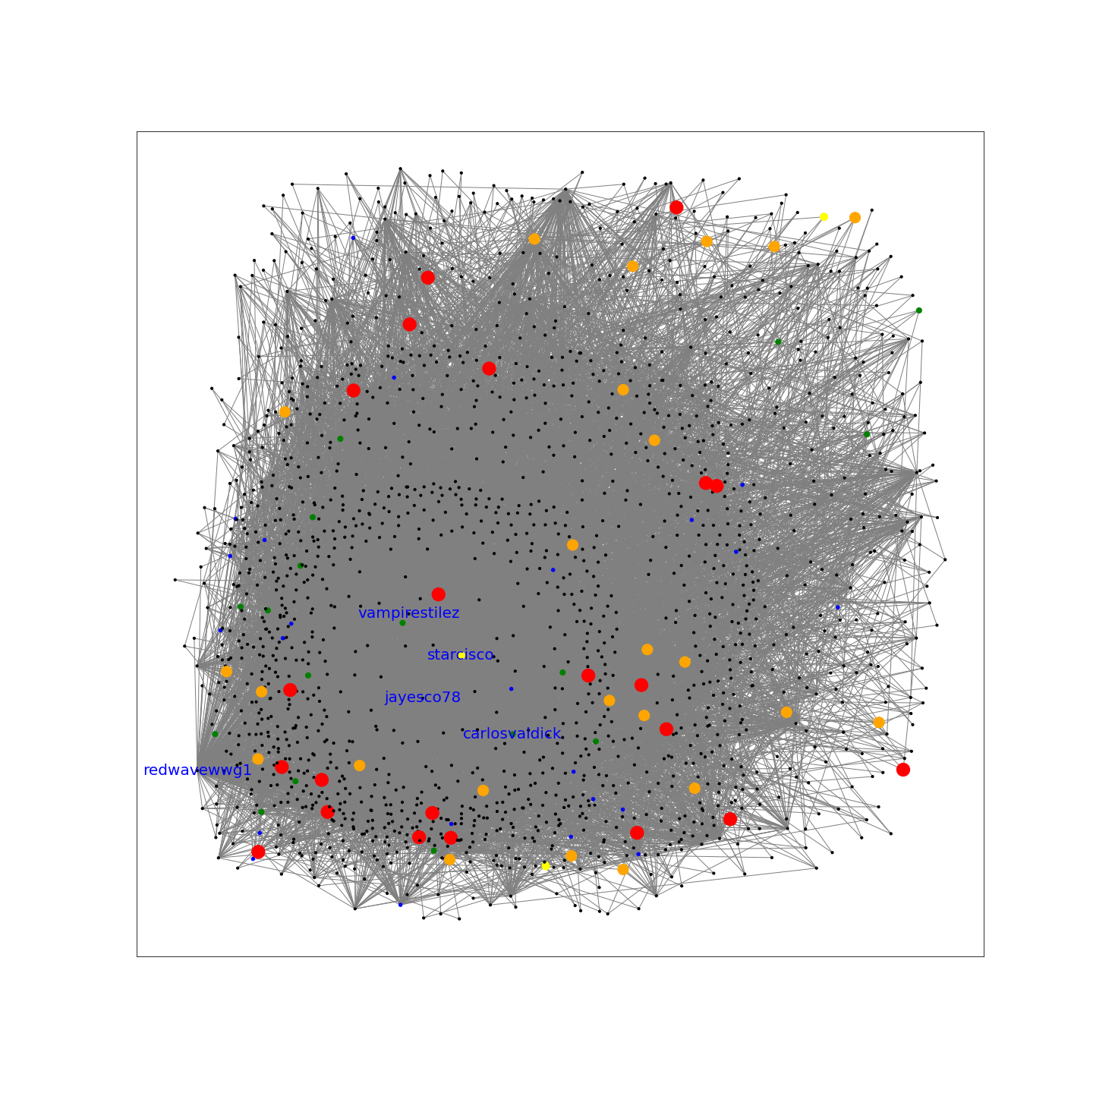
Final state at peak TPH
Average centrality = 0.005
Maximum Centrality = 0.29
Average closeness = 0.317
Maximum Closeness = 0.45
Average betweeness = 0.001
Maximum betweenness = 0.246

Slide 17
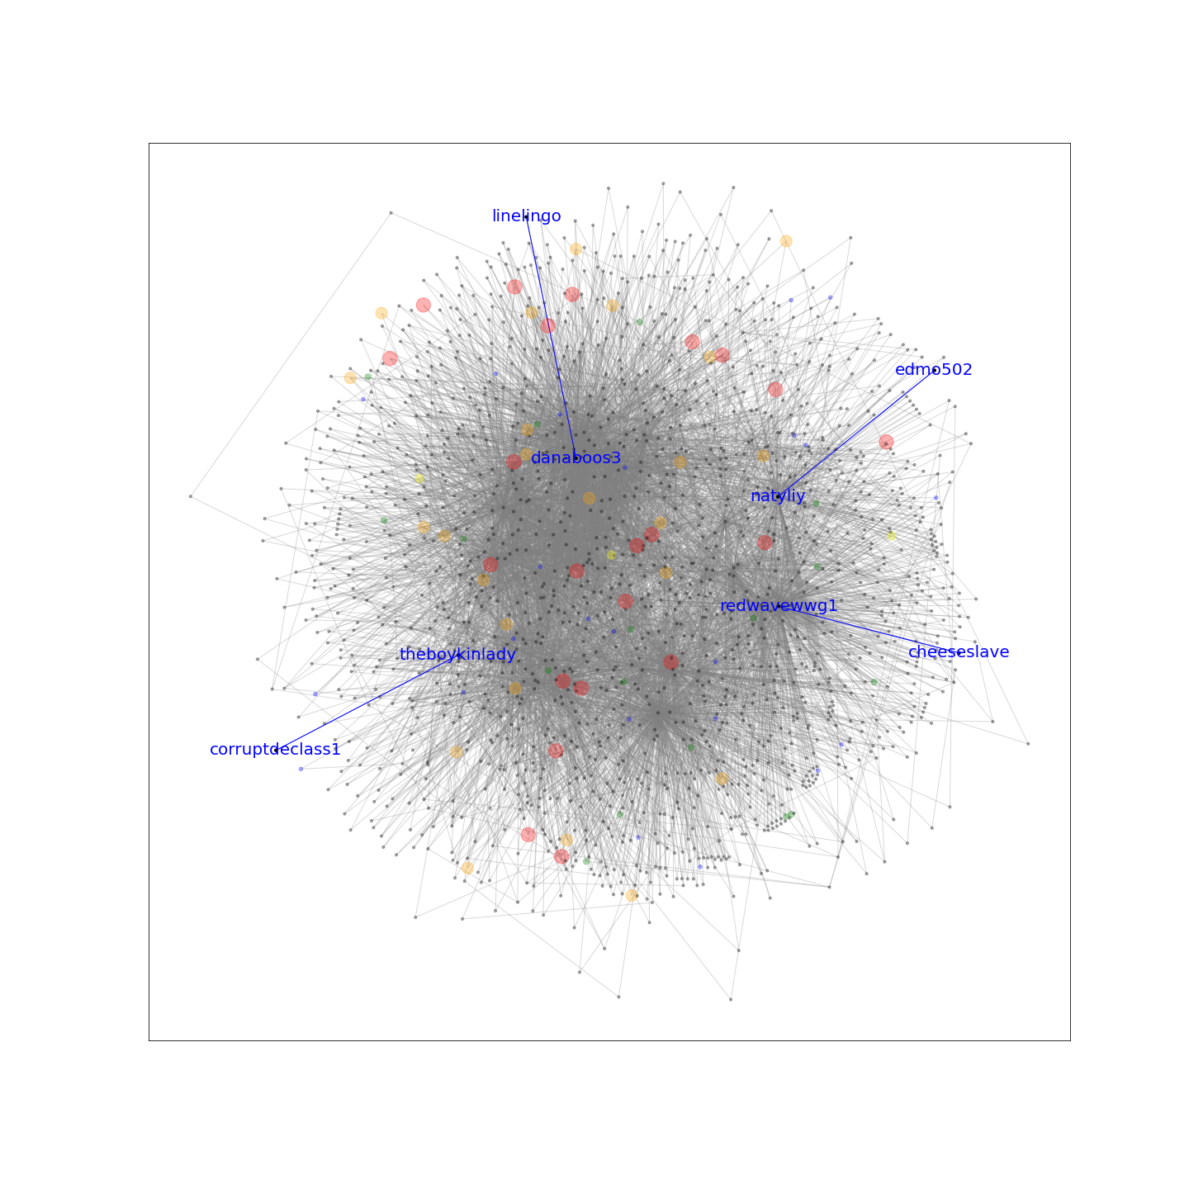
4 bridge links were measured as critical links, contributing to the structure of the network All nodes were nonBot

Slide 18
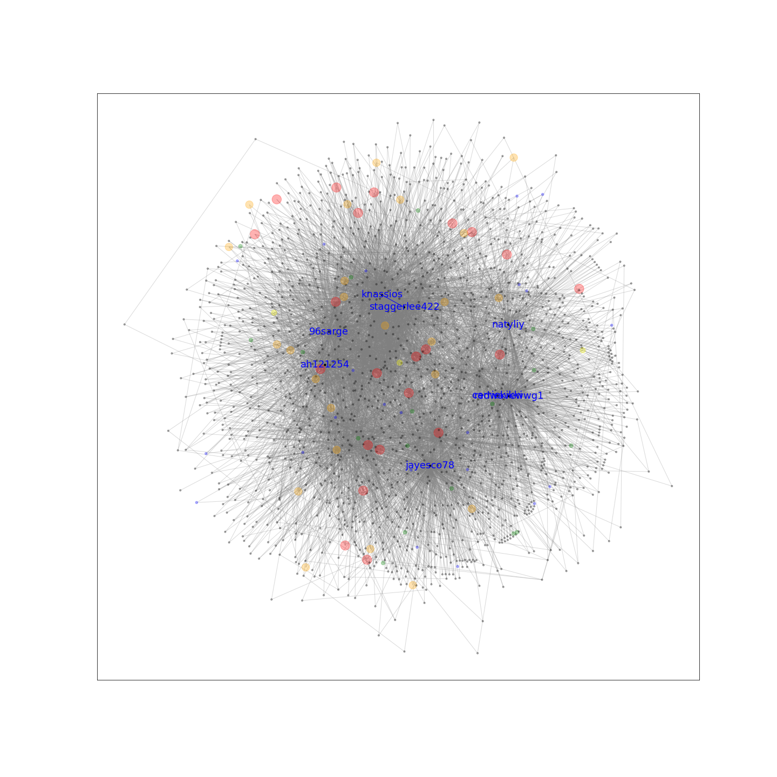
Network of high centrality nodes Blue nodes are highest degree centrality (most influence of followers) Also all nonBot

Slide 19
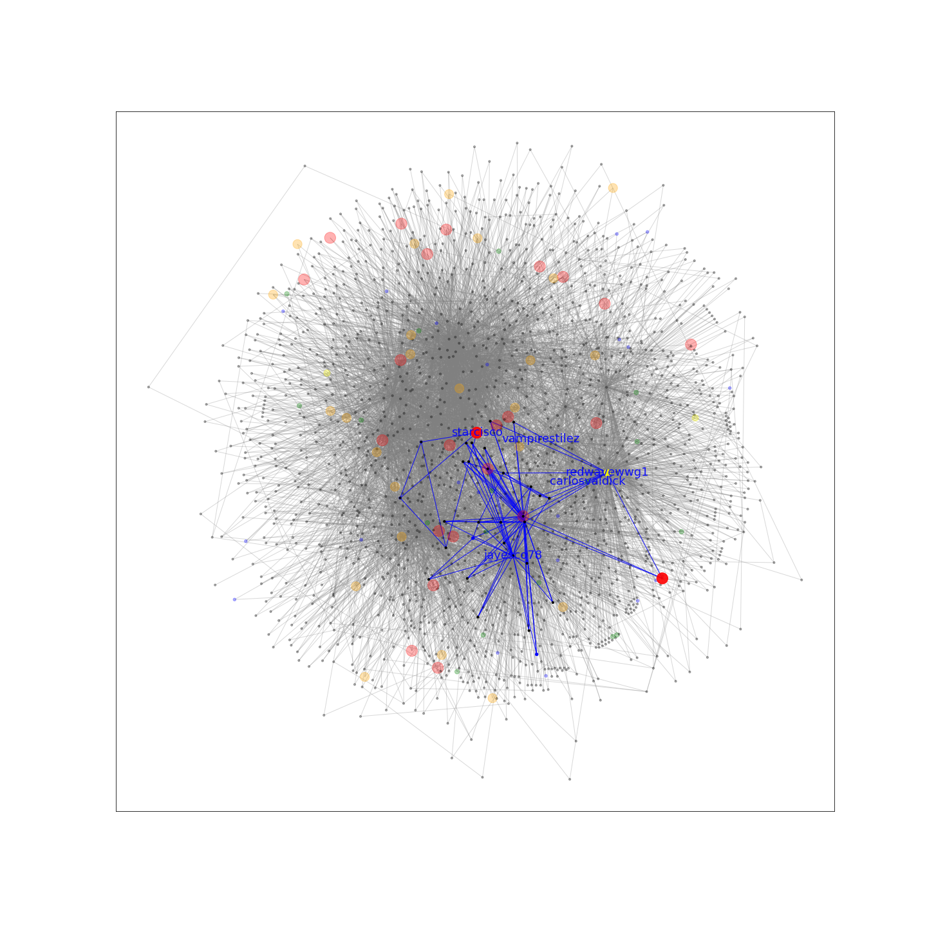
27 Cliques are derived of size 4 user accounts each containing targets listed by Alex Goldenberg 2 bots included in cliques

Slide 20
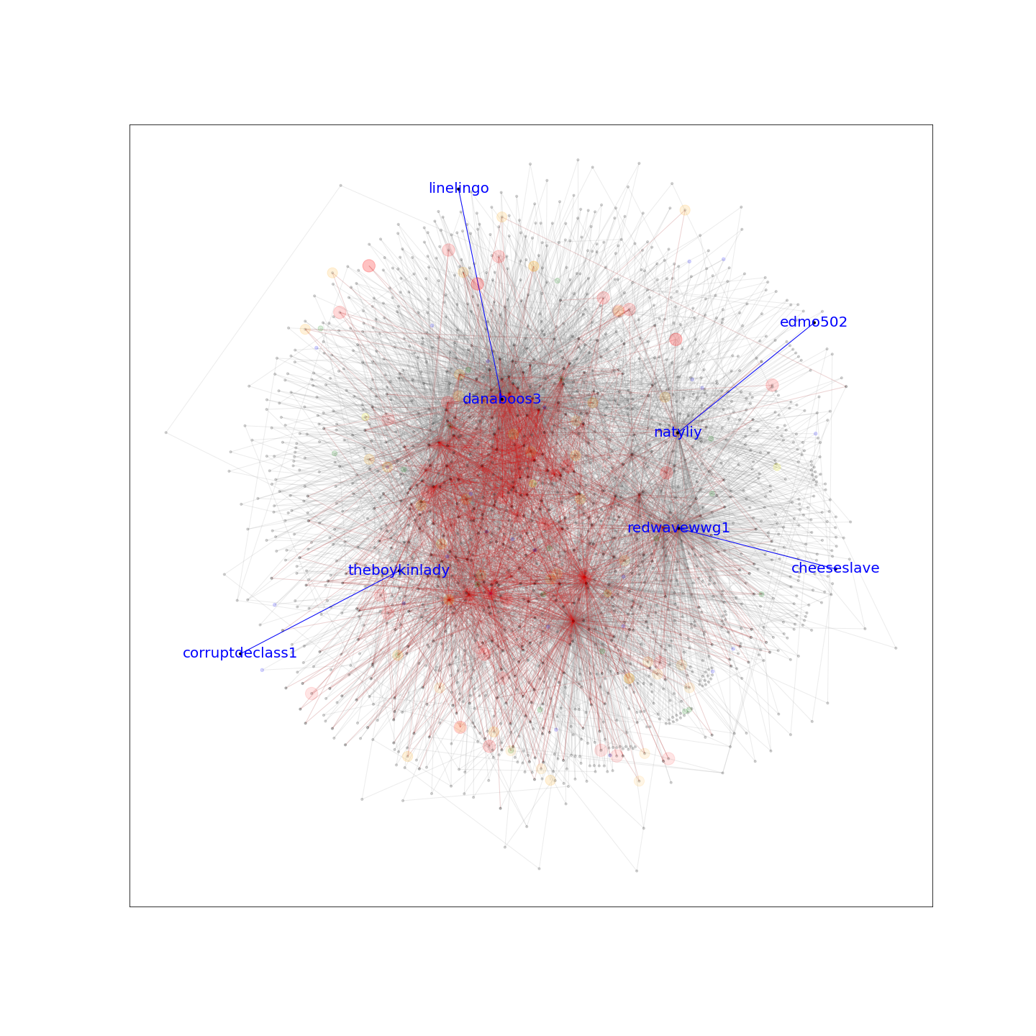
Bots overlayed with the bridge nodes and links Areas of bots connect to ends of bridges

Slide 21
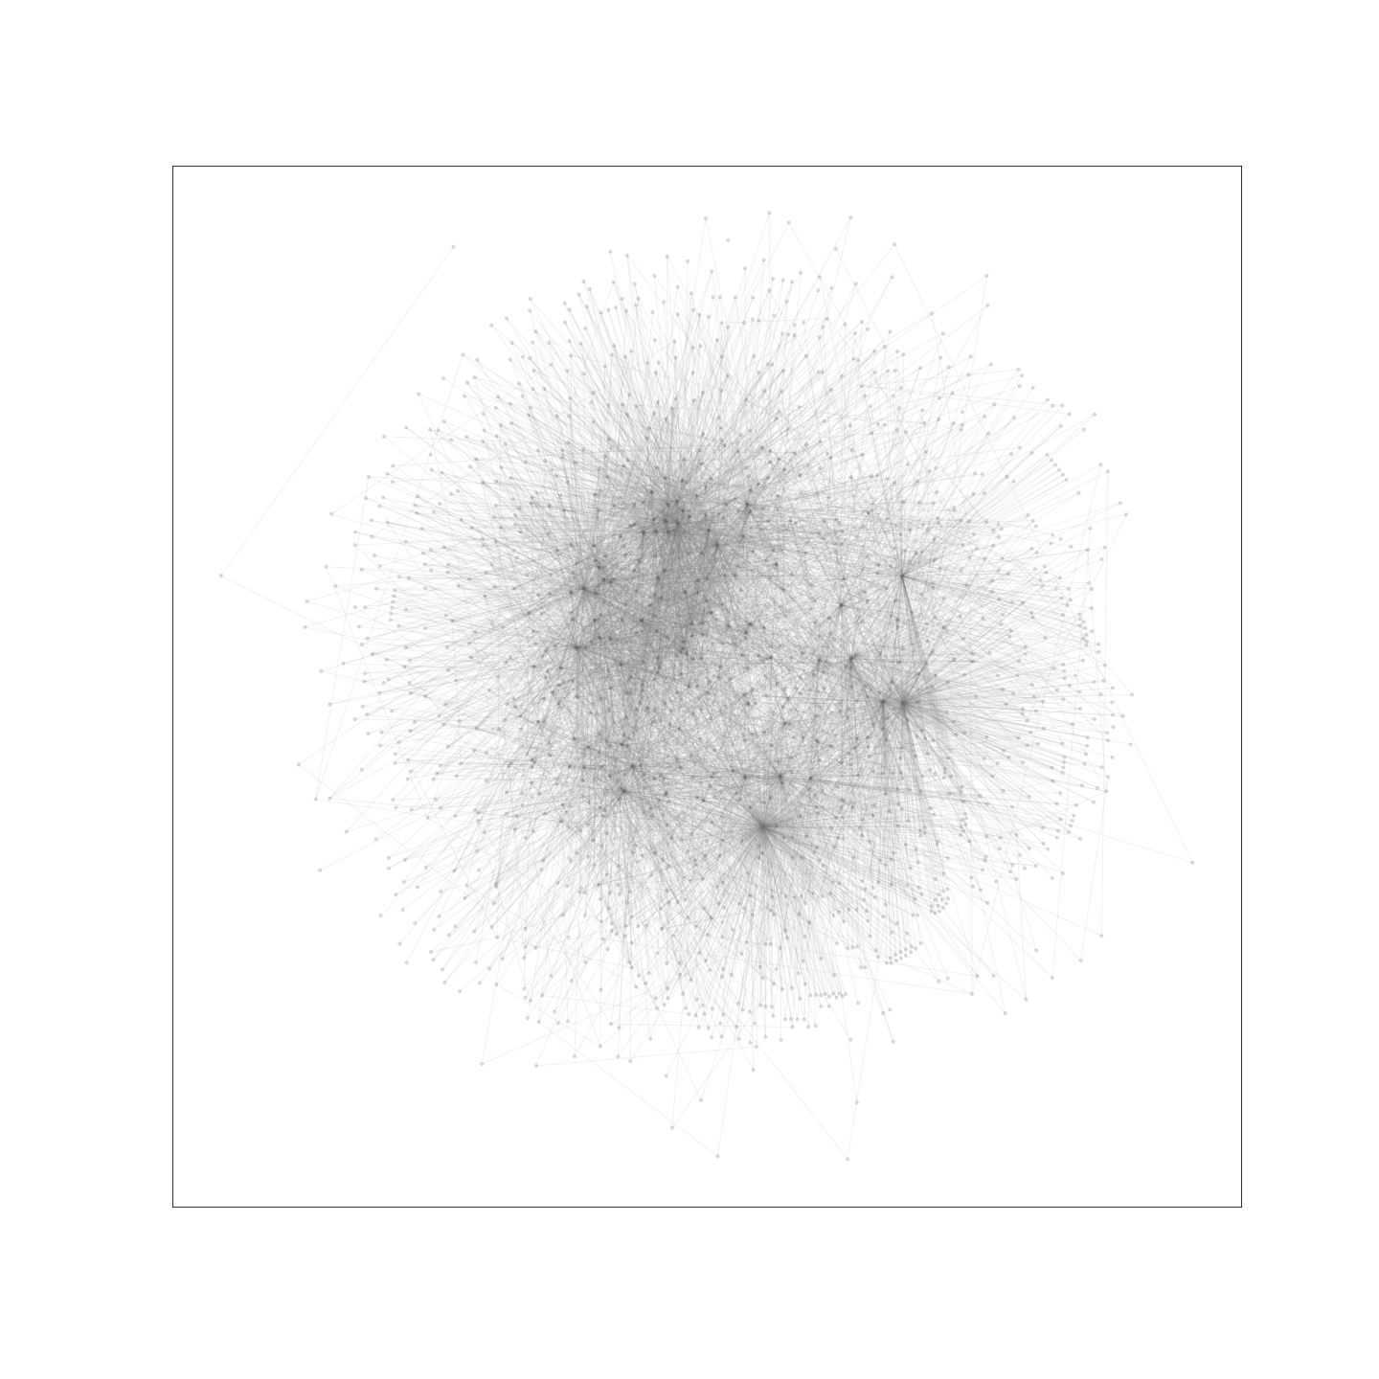
Removing bot nodes and measuring the difference in the network
Bridges increased from 4 to 60
Average centrality reduced 0.001
Average closeness reduced slightly 0.01
Average betweenness reduced slightly 0.0003

Slide 22
Major takeaways and conclusions
Based on connectivity and rate of tweeting BidenCheated, bots (scored by botometer) did not appear to have as much influence in this scenario.
The three targets were not scored as bots
The main connected nodes were not bots
Though bots contribute to the spread of disinformation (especially with higher rate of tweets), the network observed in this scenario relied on bridge connections of users that did not appear to be bots.
Bots are likely effective when used in conjunction with the non-bot accounts
Results confirm findings from literature
Vosoughi, Soroush, Deb Roy, and Sinan Aral. "The spread of true and false news online." Science 359.6380 (2018): 1146-1151.

Slide 23
Future work with this dataset and measurements
This data can contribute to a collection of scenarios that can represent disinformation spread based on environmental variables:
Bot influence
Network topology
Rate of tweet
From observed scenarios models can be developed that represent the spread of disinformation based on the environment
These models can run in a simulated environment to better understand and forecast rate of disinformation spread based on the environment

